Slide 1
Dhruv Sengar
Computer Vision

Slide 2
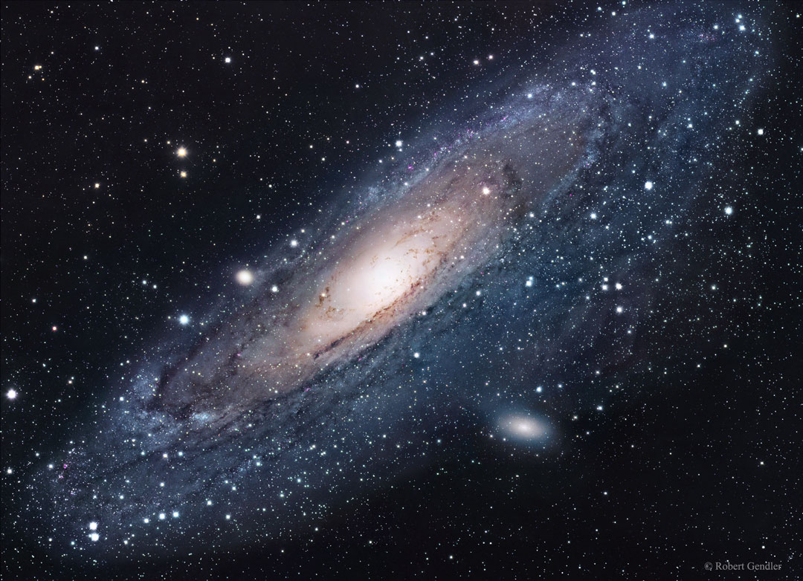
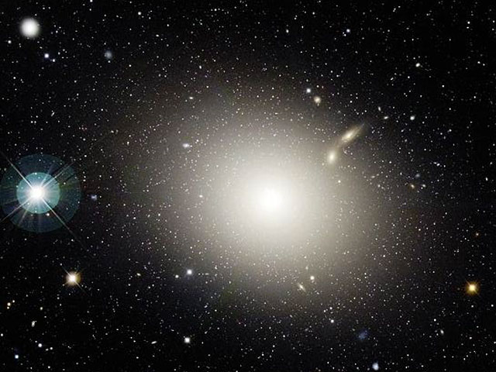
Galaxy Images Classification
Project Goal: Classify whether image is Spiral or Elliptical galaxy.

Slide 3
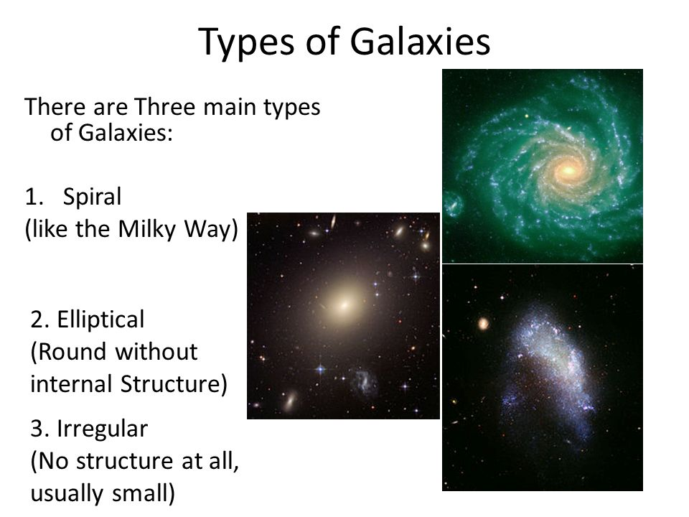

Slide 4



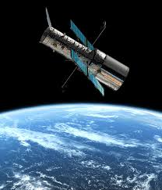


Tech used:
Amazon Web Services
Python
Keras
Tensorflow
Hubble Images
Computer Vision (CNN)

Slide 5
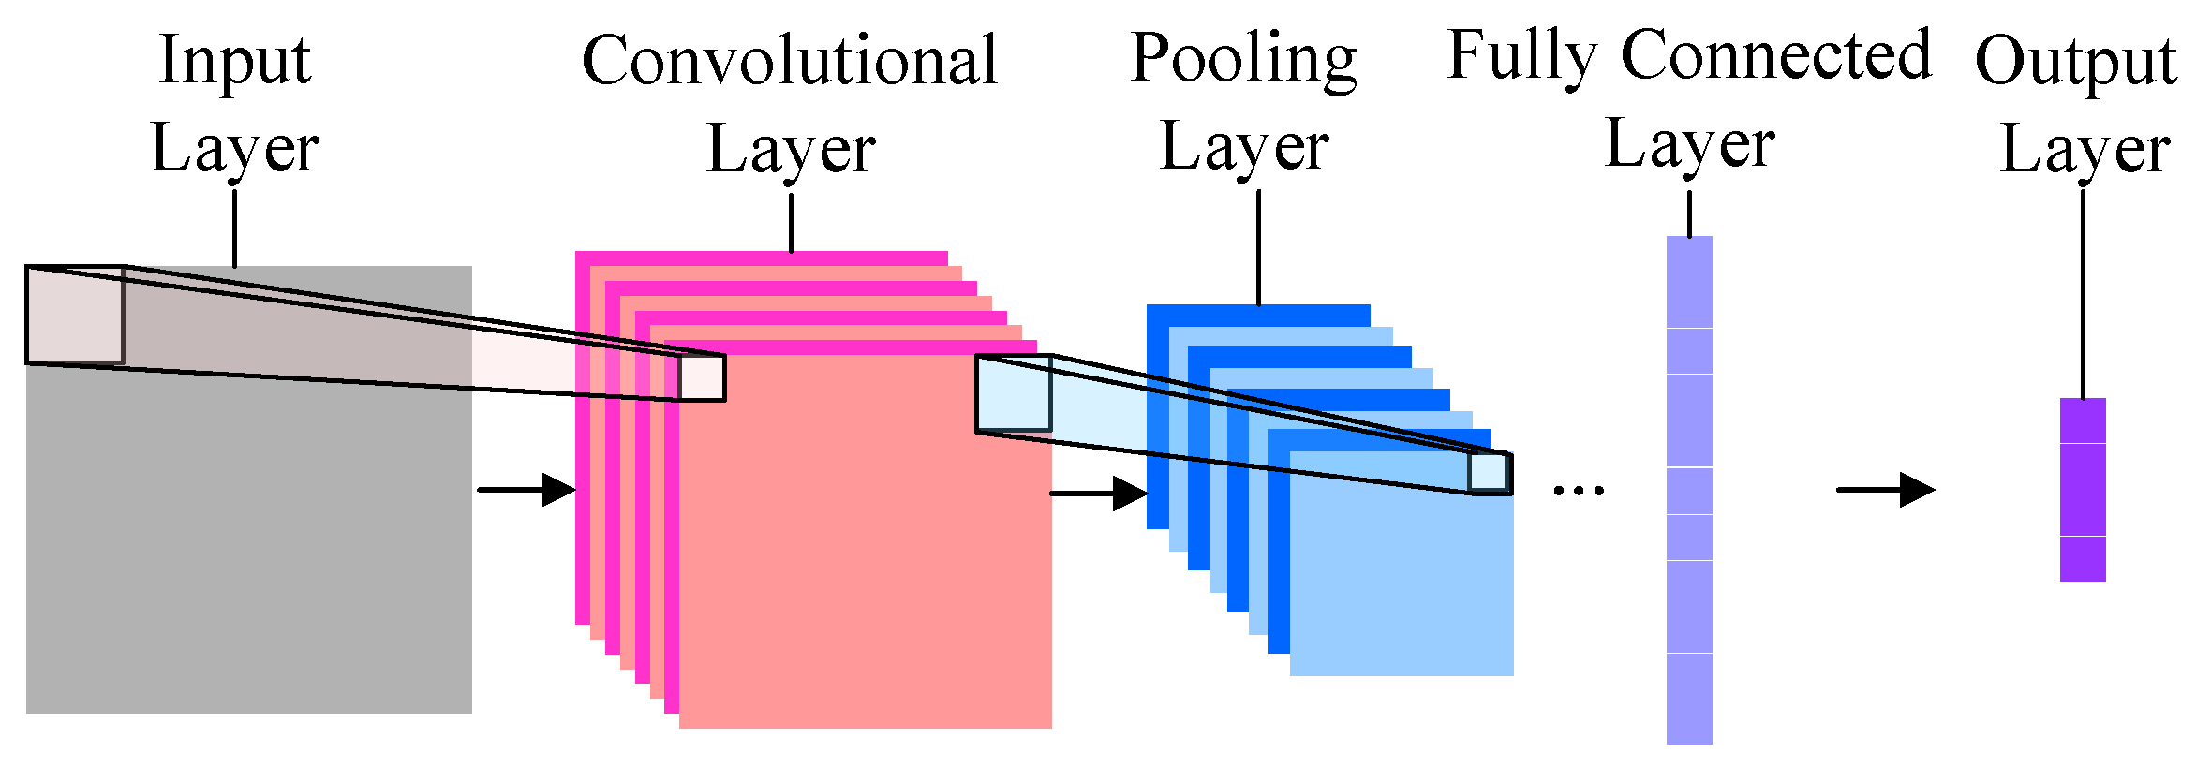
Convolutional Neural Network

Slide 6
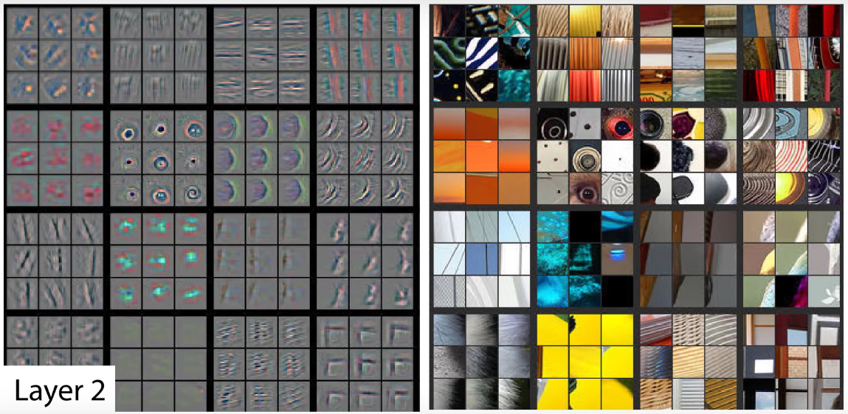

Slide 7


Slide 8
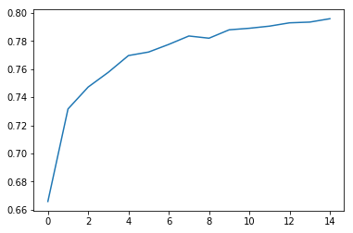
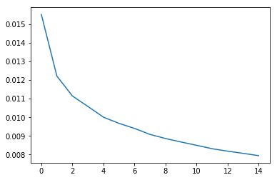
Results
Loss
accuracy
epoch
epoch

Slide 9
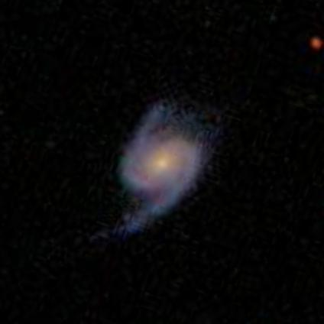
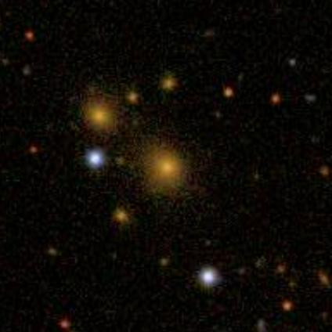
Spiral: 98.72% accuracy
Elliptical: 76.49% accuracy

